Slide 1
Tax Withholding Workshop Internships and Employment
Financial Services - Payroll
University of Chicago
May 22, 2013

Slide 2
Overview
Pre-Employment Checklist
Employment Forms
Taxes
Year End Tax Forms
Questions

Slide 3
Pre-Employment Checklist
You have a job (and authorization to work).
Working on-campus (UChicago) – no additional work authorization needed
Working on CPT/Academic Training – Cannot begin work until date listed on I-20 (page 3) or DS-2019 (line item 5)
Working on OPT – Cannot begin work until receiving EAD and start date of card

Slide 4
Pre-Employment Checklist
You have a Social Security Number (or will apply for one)
See https://internationalaffairs.uchicago.edu/page/what-social-security-number for social security application instructions
F-1 CPT: apply up to 30 days before start date
F-1 OPT: apply only after EAD start date is reached
J-1 Academic Training: can apply after AT authorization is placed on DS-2019
On-Campus Employment: can apply only after start date of job

Slide 5
Pre-Employment Checklist
You know your tax residency status (Resident for Tax or Nonresident for Tax)
Determined by Substantial Presence Test (SPT)
Generally, if an F or J student who arrived in the US…
- in 2009 or after = Non-Resident for Tax
- in 2008 or prior = Resident for Tax
*Review IRS publication 519 or PowerPoint (2013 Tax Workshop Presentation) for further details

Slide 6
Substantial Presence Test
Counts days of physical presence in
the US.
Current Year x 1 ________
1st Previous Year x 1/3 ________
2nd Previous Year x 1/6 ________
If equals 183 days or more = Resident for Tax
If equals 182 days or less = Non-Resident for Tax
EXCEPTIONS TO SPT
F or J students receive 5 “exempt” years. Not exempt from tax, but of counting physical days of presence in the US towards SPT
J Non-Students receive 2 “exempt” years (of the past 6 years)
“Exempt” years are CALENDAR years, not years from date of arrival

Slide 7
Employment
If working on CPT or OPT – may be considered an Employee or Independent Contractor (IC)
Employee: relationship where services are performed under the direction of employer
Independent Contractor: services are usually performed on independent basis for outcome
May actually be an employee/er relationship, but paid as an IC – because this is easier for 'employer'. Immigration wise this is okay, but may create tax issues for nonresidents for tax

Slide 8
Employment Forms
I-9 – Employment Eligibility Verification
Intake Form/Software (Residency Determination)- optional
W4 – Employee Withholding Allowance Certificate
State Tax Forms – Employee's State Withholding Allowance Certificate
8233 and Statement – Optional: Tax Treaty Eligible Only
W9 Form – Only for Residents for Tax
Various Employer Specific Forms

Slide 9
I-9 Form
Form is required to be completed by employee
To be completed by employee on first day of employment and certified by employer within 3 days of start date
Employer must verify actual documents, not photocopies
Employer cannot ask for certain documents for verification; must provide you with the list of acceptable documents. Cannot use a Social Security card that states 'Valid for Work only with DHS Authorization' for I-9 verification

Slide 10
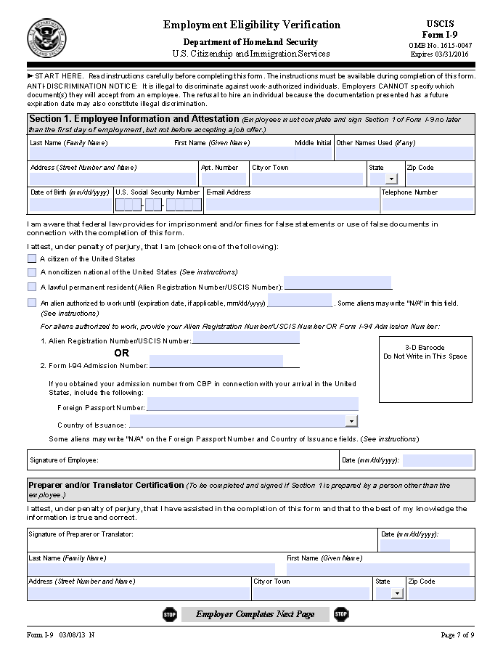
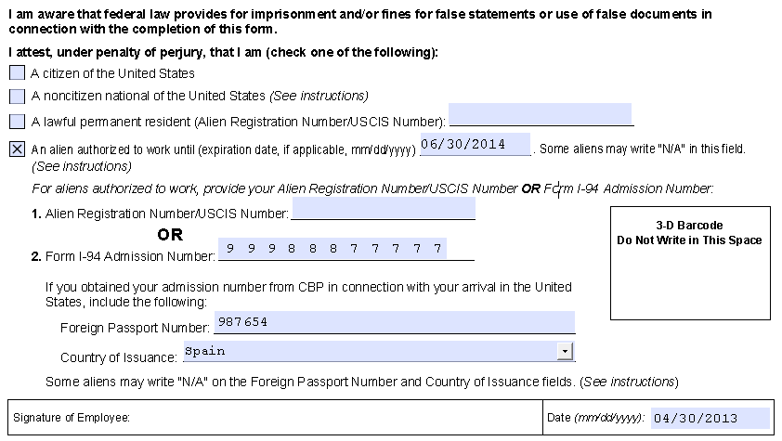
I-9 Form
Juan Garcia

Slide 11
W4 and State Withholding Form
Purpose: To instruct the employer on how you want your tax withholding applied
The highest tax rate is ‘Single’ and ‘0’ allowances – which is the default
Allowances are reflected on the yearend tax return as a deduction from taxable income
So, if you claim more allowances than allowed, you will have under-withholding at year end
Since nonresidents cannot claim certain allowances and married status (typically), then they are limited as to how they complete the W4 form.
Each state with a state tax will have a state withholding form. Some states follow federal guidelines, some do not, it is important to know the rules of the state of employment (Illinois follows federal regulations)

Slide 12
W4 and State Withholding Form
Nonresident for Tax – must adhere to Non-Resident Withholding Rules
- Single (even if married)
- Only 1 allowance (line 5)
Residents for Tax – may complete form however you wish
If form is completed incorrectly, or not submitted, you will be taxed at "Single" "0" allowances

Slide 13
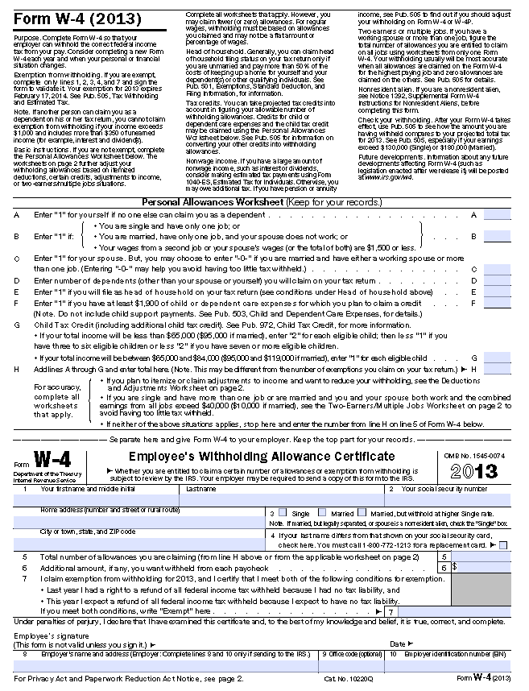
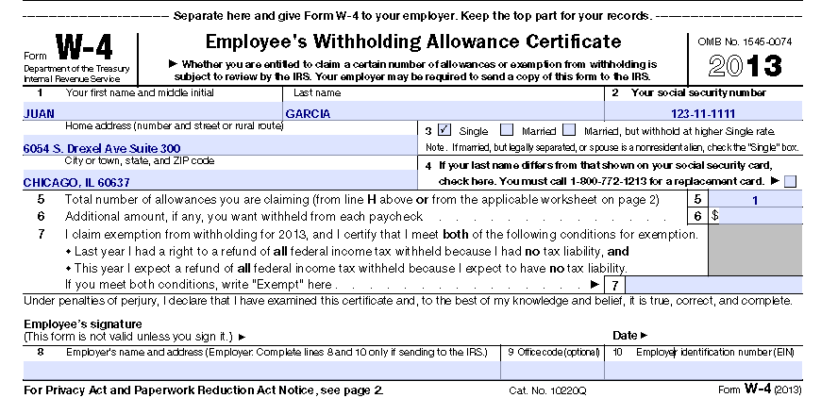
Juan Garcia 4/30/2013

Slide 14
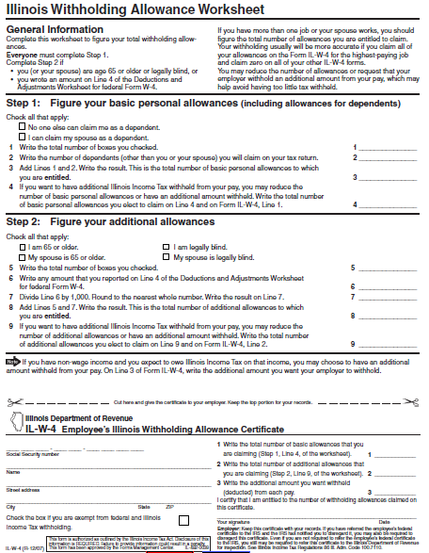
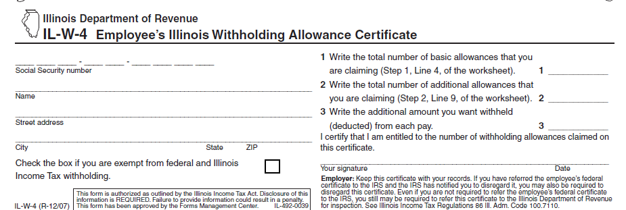
1 2 3 1 1 1 1 1 1
1
Juan Garcia
6054 S. Drexel Ave #300
Chicago IL 60637
Jose Reyes 04/31/13

Slide 15
Independent Contractor Forms
Intake Form/Software (Residency Determination) – optional
W9 – Resident for Tax Only
Various "Employer" Specific Forms
Note: If you own your own business - separate business taxes may apply. Review IRS regulations.

Slide 16
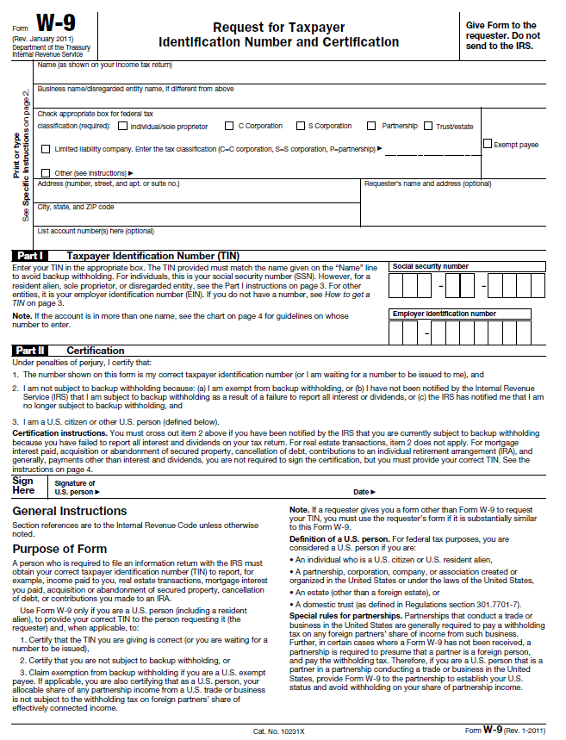
W9 Form

Slide 17
Taxes – How they work
Income
Salary
- Wages
- Compensation
Taxes Paid
Withheld from payments (W4)
OR
Tax Return
File a year-end tax return to reconcile the total income earned and the estimated taxes already paid.
Independent Contractor Payments
Make estimated tax payments (1040-ES)

Slide 18
Taxes
Employer Relationship
Independent Contractor Relationship
Non-Resident (NRA) – 30% in federal tax withheld only
Resident (RA) – No taxes withheld
State Tax
Federal Tax
OASDI and Medicare
Taxes Withheld

Slide 19
Federal Taxes
Employer
Taxes withheld according to Income Tax Withholding Table and W4
Nonresidents are not eligible for the Standard Deduction, so additional amounts may be added to taxable income
Exempt from federal taxes only with a valid tax treaty
Independent Contractor
NRA – Federal taxes withheld at standard 30%
RA – No tax withheld, but does not mean no taxes are owed. Must pay estimated quarterly payments using form 1040-ES/1040-ES (NR)

Slide 20
Illinois State Taxes
Employer
Taxes withheld according to IL regulations and IL-W-4 = 5% of taxable income.
Based on normal taxable income only – no additional amounts added to taxable earnings
Exempt from Illinois taxes only with a valid tax treaty
Some states may not have a state tax, or will have a local tax in addition to state tax. Regulations vary with each state
Independent Contractor
NRA – No tax withheld, but does not mean no taxes are owed. Must pay estimated quarterly taxes using form IL-1040-ES. Read requirements
RA – No tax withheld, but does not mean no taxes are owed. Must pay estimated quarterly taxes using form IL-1040-ES. Read requirements
Be aware of individual state requirements for estimated payments. Some states may withhold state/local taxes on IC services

Slide 21
FICA/Medicare Taxes
Employer Relationship
NRA holding F or J visa – No SS tax should be withheld
RA – SS tax will be withheld at 7.65%. This is a non-refundable tax and is required
These taxes can be erroneously withheld. If you believe these taxes are withheld in error, consult with your payroll department
Independent Contractor Relationship
NRA – These taxes will not be withheld and you will not have a liability for these taxes
RA – These taxes will not be withheld, but you may have a liability for these taxes – See Self-Employment - Schedule SE on IRS website www.irs.gov

Slide 22
Year End Tax Forms
Employer Relationship
W2 – Summary of calendar year earnings. Mailed by January 31. Make sure employer has correct address to mail form. (If a tax treaty was taken, form 1042-S will also be mailed by March 15)
Independent Contractor Relationship
NRA – 1042S form. Mailed by March 15. Make sure employer has correct address
RA – 1099 form. Mailed by January 31. Make sure 'employer' has correct address

Slide 23
Tips
Read over and understand the forms
Make sure taxes are correct – if you're not sure, ASK!
Some companies will not pay you correctly – question the process, and make notes for year end tax return process
Keep your address updated so you will receive the forms in a timely manner
Make sure you are paying estimated taxes if required.

Slide 24
Questions
Lerone Moore
6054 S. Drexel Ave, Suite 300
773.834.2672
leronemoore@uchicago.edu
Angie Gleghorn
6054 S. Drexel Ave, Suite 300
773.702.5989
gleghorn@uchicago.edu

